Slide 1
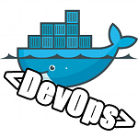
Get start with Docker & DevOps
Sr.Analyst Oksana Dudnik

Slide 2
Let’s start with Docker ToolBox
At first we must install Docker ToolBox on local computer:
Go to the Docker Toolbox page.
https://www.docker.com/products/docker-toolbox
Download and install (close all another programs).

Slide 3
Let’s create docker-machine
In FAR or in Git CMD(run as administrator) :
>docker-machine create –driver virtualbox –virtualbox-memory 4096 default
If there now errors:
>docker-machine create –driver virtualbox –virtualbox-memory 4096 adop
>docker-machine ls
NAME ACTIVE DRIVER STATE URL SWARM DOCKER ERRORS
adop * virtualbox Running tcp://192.168.99.101:2376 v1.10.3
default - virtualbox Running tcp://192.168.99.100:2376 v1.10.3

Slide 4
CREATE environment variables
>SETX DOCKER_MACHINE_NAME “adop”
>SETX DOCKER_HOST “tcp://192.168.99.101:2376”
>SETX DOCKER_CERT_PATH “C:\Users\oksana.dudnik\.docker\machine\machines\adop”
>SETX DOCKER_TLS_VERYFY “1”

Slide 5
setx LDAP_PWD "Jpk66g63ZifGYIcShSGM“
setx LDAP_DOMAIN "ldap.example.com“
setx LDAP_FULL_DOMAIN "dc=ldap,dc=example,dc=com“
setx GERRIT_MYSQL_USER "gerrit“
setx GERRIT_MYSQL_PASSWORD "gerrit“
setx GERRIT_MYSQL_DATABASE "gerrit“
setx GERRIT_USER_NAME "Gerrit Code Review"
setx GERRIT_USER_EMAIL "gerrit@adop“
setx SONAR_MYSQL_USER "sonar“
setx SONAR_MYSQL_PASSWORD "sonar“
setx SONAR_MYSQL_DATABASE "sonar“
setx SONAR_ACCOUNT_LOGIN "jenkins“
setx SONAR_ACCOUNT_PASSWORD "jenkins“
setx SONAR_DB_LOGIN "%SONAR_MYSQL_USER%“
setx SONAR_DB_PASSWORD "%SONAR_MYSQL_PASSWORD%“
setx DOCKER_CLIENT_CERT_PATH “//root/.docker/”

Slide 6
Received environment variables
CERT_PATH=$0 //root/.docker/
CLIENT_SUBJ=/CN=client
CUSTOM_NETWORK_NAME=adopnetwork
DOCKER_CERT_PATH=C:\Users\oksana.dudnik\.docker\machine\machines\adop
DOCKER_CLIENT_CERT_PATH=//root/.docker/
DOCKER_HOST=tcp://192.168.99.101:2376
DOCKER_MACHINE_NAME=adop
DOCKER_TLS_VERIFY=1
DOCKER_TOOLBOX_INSTALL_PATH=C:\Program Files\Docker Toolbox

Slide 7
Envorment variables
GERRIT_MYSQL_DATABASE=gerrit
GERRIT_MYSQL_PASSWORD=gerrit
GERRIT_MYSQL_USER=gerrit
GERRIT_USER_EMAIL=gerrit@adop
GERRIT_USER_NAME=Gerrit Code Review
HOME=/root
HOMEDRIVE=C:
HOMEPATH=\Users\oksana.dudnik
HOST=192.168.99.100
LDAP_DOMAIN=ldap.example.com
LDAP_FULL_DOMAIN=dc=ldap,dc=example,dc=com
LDAP_PWD=Jpk66g63ZifGYIcShSGM

Slide 8
Envorment variables
LOGSTASH_HOST=192.168.99.101
MACHINE_NAME=adop
SONAR_ACCOUNT_LOGIN=jenkins
SONAR_ACCOUNT_PASSWORD=jenkins
SONAR_DB_LOGIN=sonar
SONAR_DB_PASSWORD=sonar
SONAR_MYSQL_DATABASE=sonar
SONAR_MYSQL_PASSWORD=sonar
SONAR_MYSQL_USER=sonar
USER_HOME=C:\Users\oksana.dudnik
VOLUM_DRIVER=local

Slide 9
CREATE network
setx TARGET_HOST "192.168.99.101“
setx LOGSTASH_HOST “%TARGET_HOST%"
docker network create %CUSTOM_NETWORK_NAME%

Slide 10
Start docker-compose
docker-compose -f compose/elk.yml pull
docker-compose -f docker-compose.yml -f etc/volumes/local/default.yml -f etc/logging/syslog/default.yml pull
docker-compose pull
docker-compose -f compose/elk.yml up -d
docker-compose -f docker-compose.yml -f etc/volumes/local/default.yml -f etc/logging/syslog/default.yml up -d

Slide 11
Run docker container jenkins
>docker exec jenkins curl -I -s jenkins:jenkins@localhost:8080/jenkins/
>docker exec jenkins curl -X POST jenkins:jenkins@localhost:8080/jenkins/job/Load_Platform/buildWithParameters --data token=gAsuE35s

Slide 12
GENERATE ssl certificates
This command you must run from Git CMD as administrator
Or from program Kitematic -> PowerShell (from DockerToolBox)
>generate_client_certs.sh ${DOCKER_CLIENT_CERT_PATH}

Slide 13
Let’s go to docker-host:
Access the target host url
http://<TARGET_HOST>
with the
user john.smith
and
password Password01

Slide 14
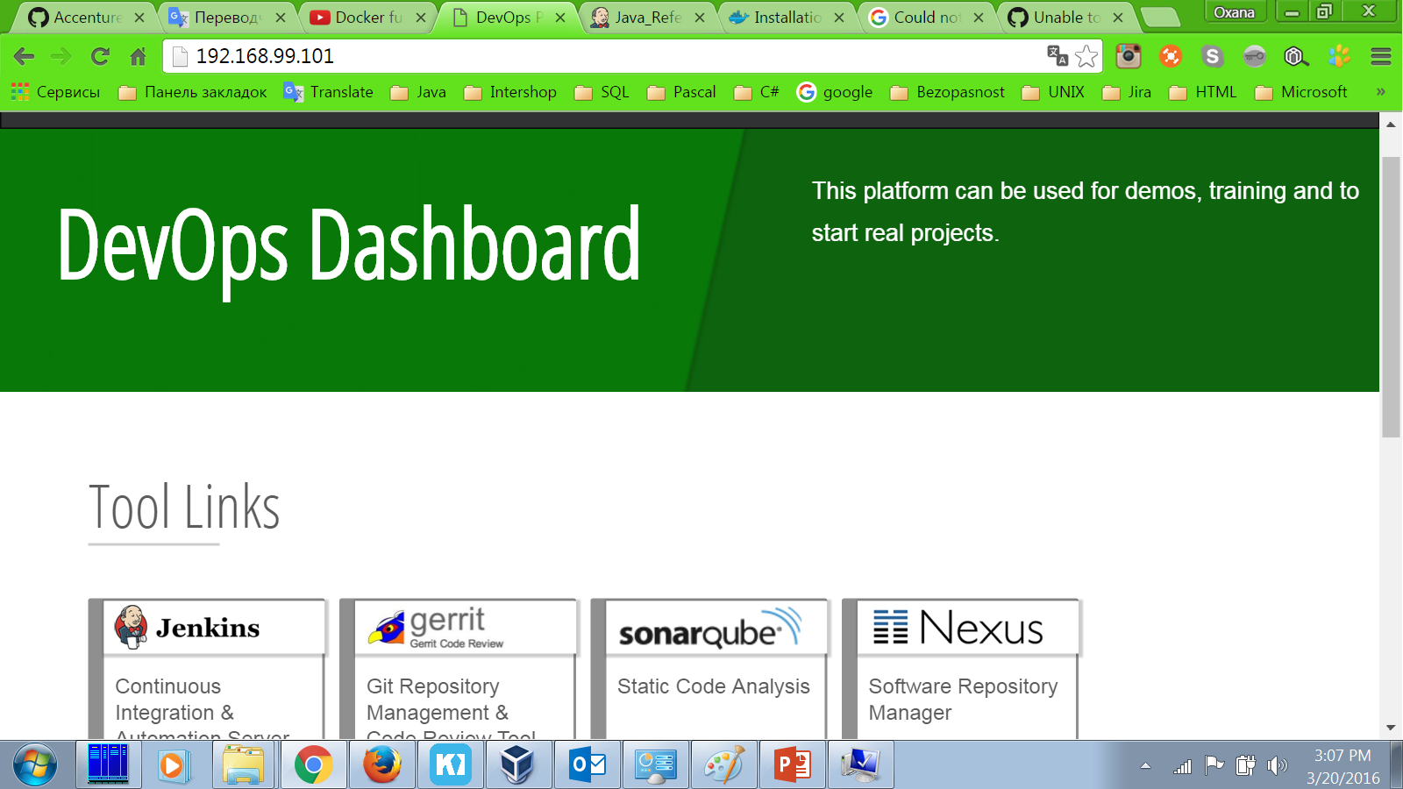
Success!

Slide 15
Prepared project PetClinic
http://<TARGET_HOST>/jenkins/job/LoadPlatform -
rebuild All downstream jobs
http://<TARGET_HOST>/jenkins/job/ExampleWorkspace/job/ExampleProject/job/Create_Environment
Click “Build with parameters”
http://<TARGET_HOST>/jenkins/job/ExampleWorkspace/job/ExampleProject/view/Java_Reference_Application/
Click “Run”

Slide 16
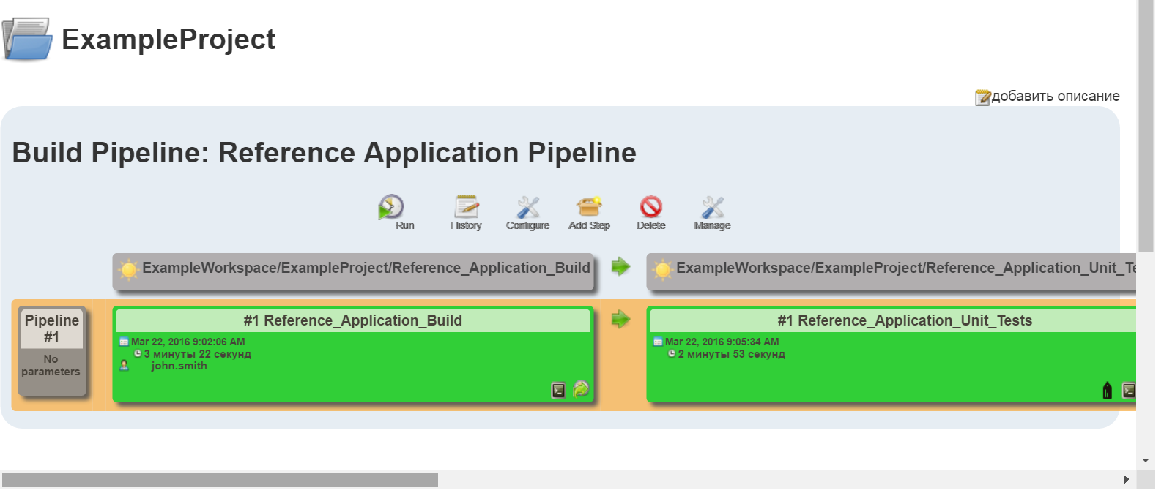
Success build and deploy!

Slide 17
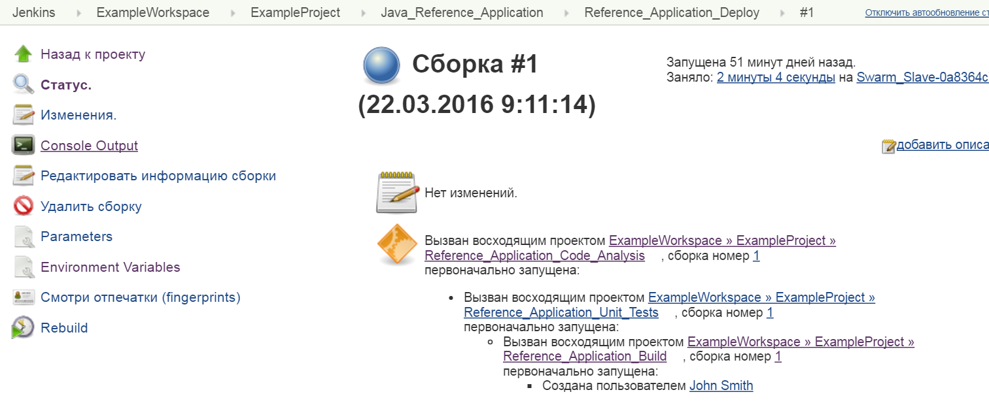
Click on link Console Output

Slide 18
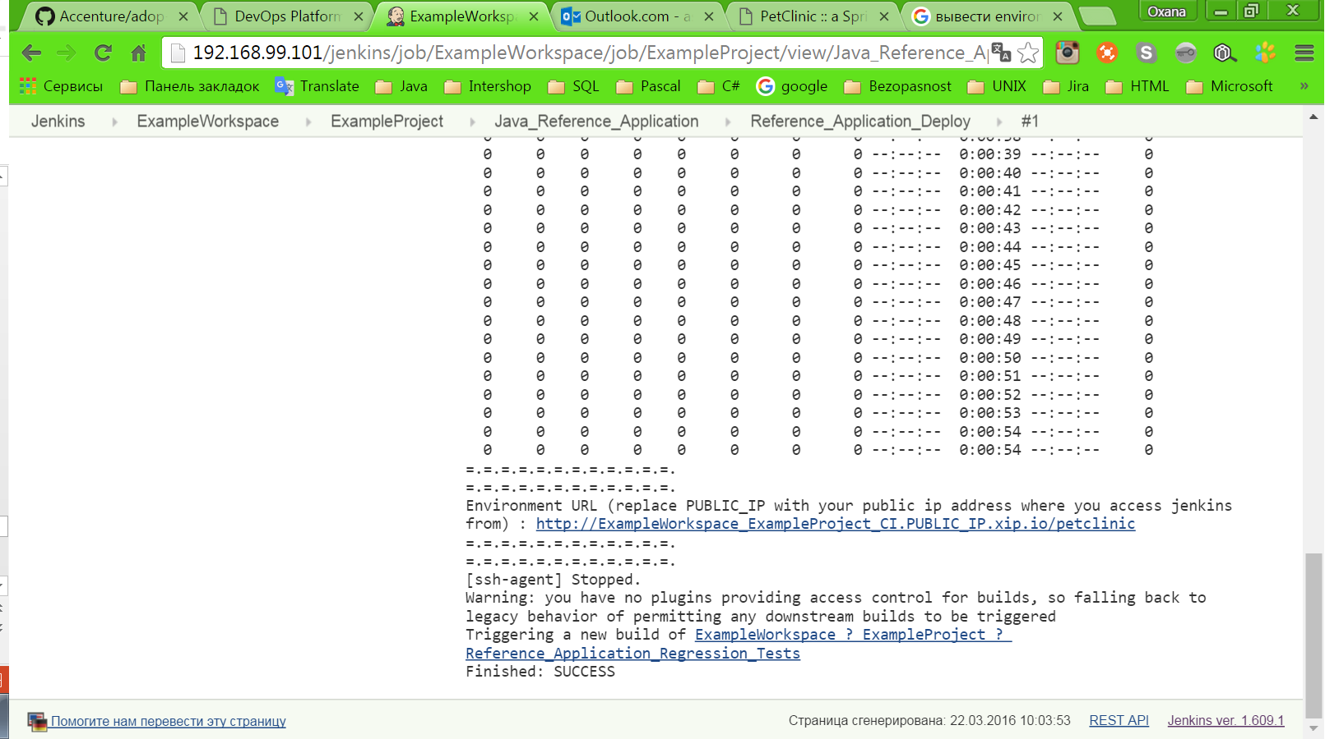
Click on Environment URL

Slide 19
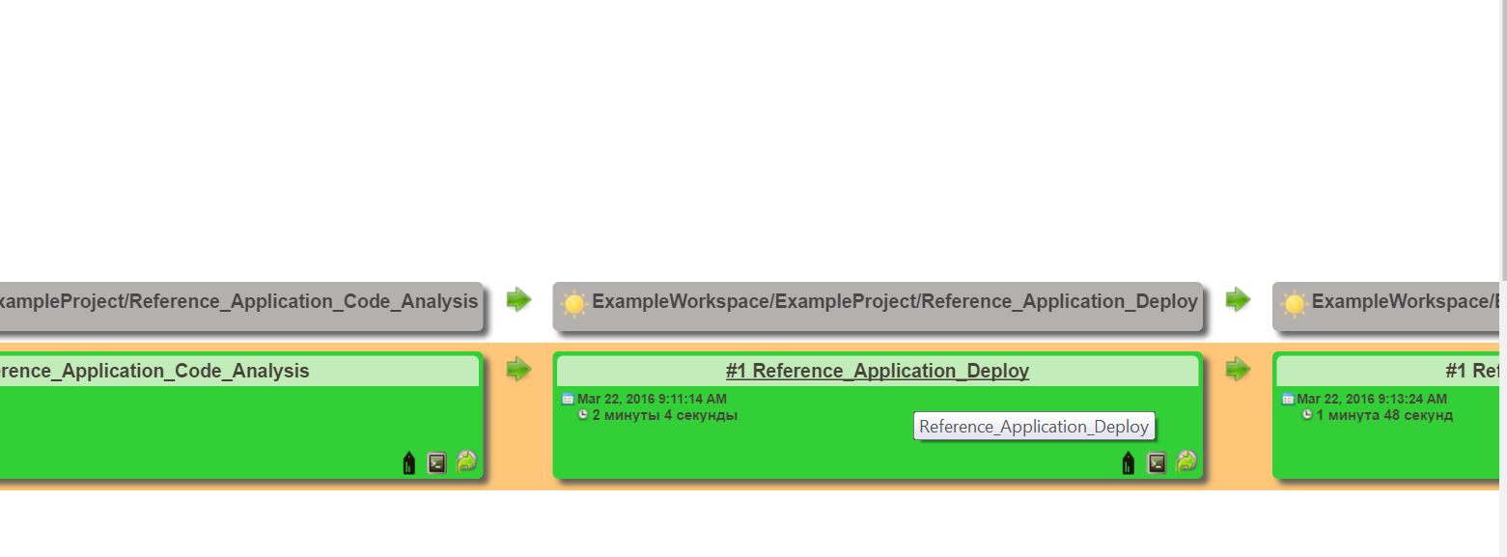
Click on link #1Reference_Application_Deploy

Slide 20
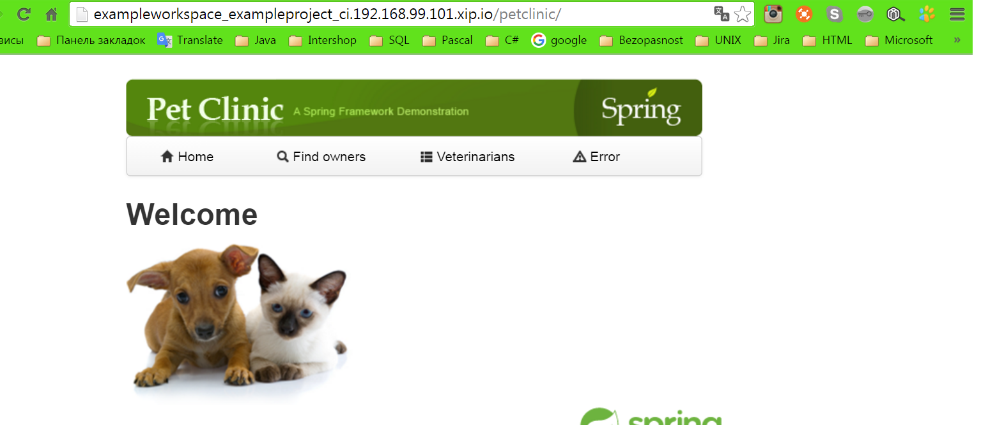
Get Result!

Slide 21
Let’s create own example
Our tasks:
Create new job for Jenkins for build project from GIT-repository
Create shell script for setup tomcat-service
Create new job for Jenkins for deploy this project with service tomcat
Create view for review our jobs

Slide 22
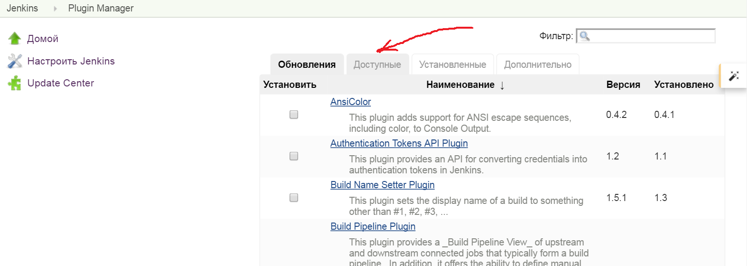
Let’s install Jenkins Job DSL plugin

Slide 23
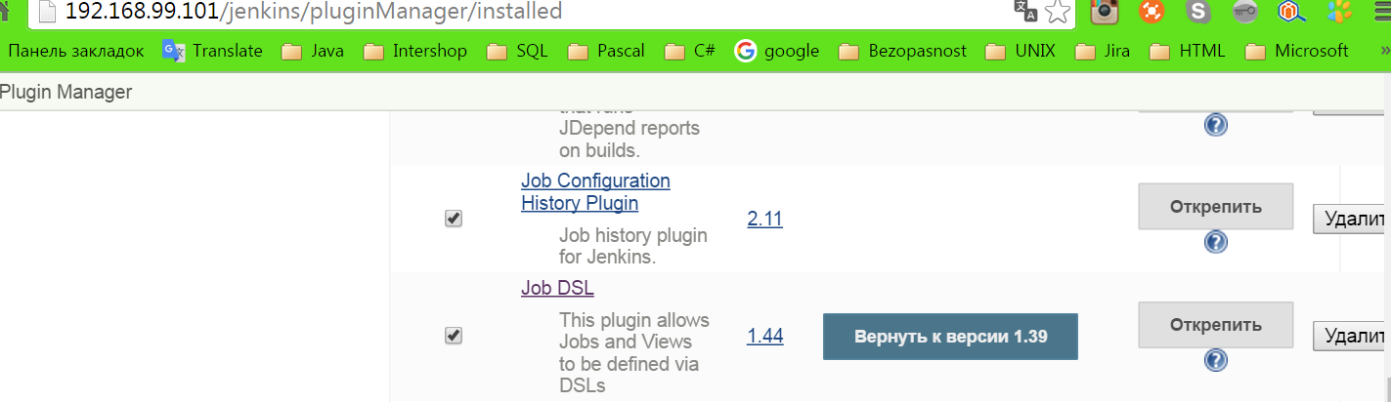
Let’s check if installed

Slide 24
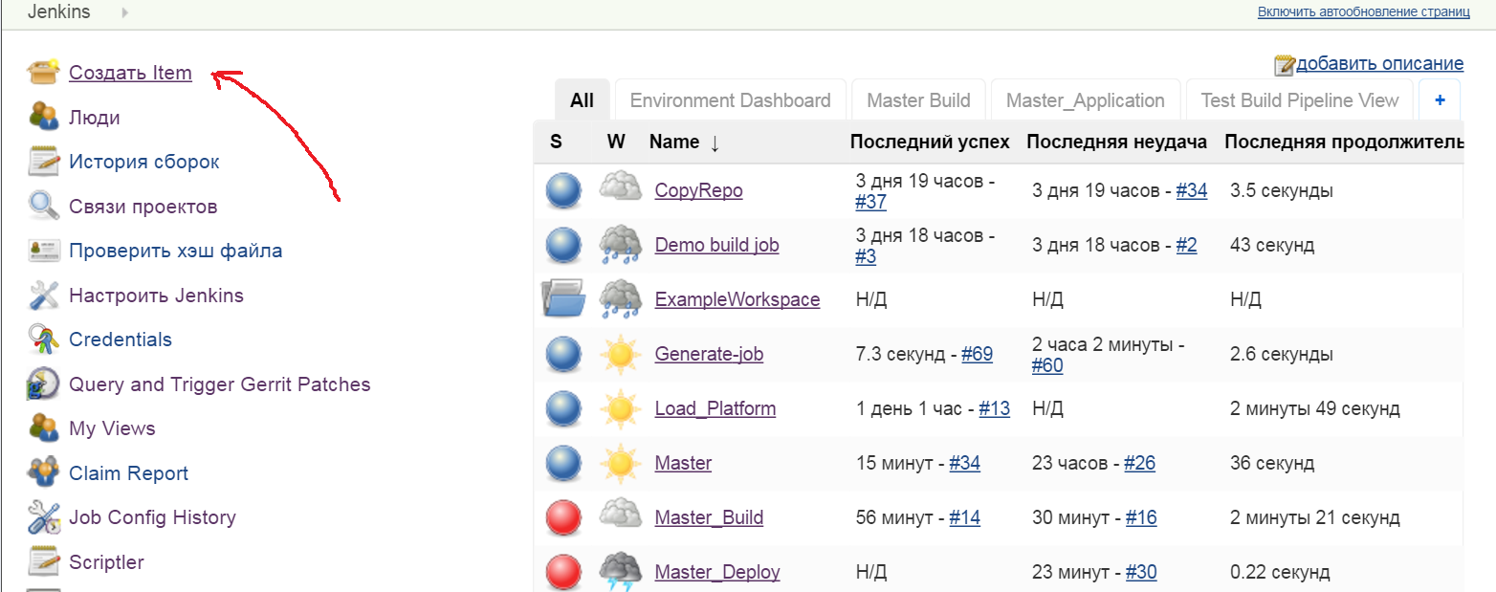
Let’s create freestyle initial job which will be generate another jobs : tomcat setup, build, deploy

Slide 25
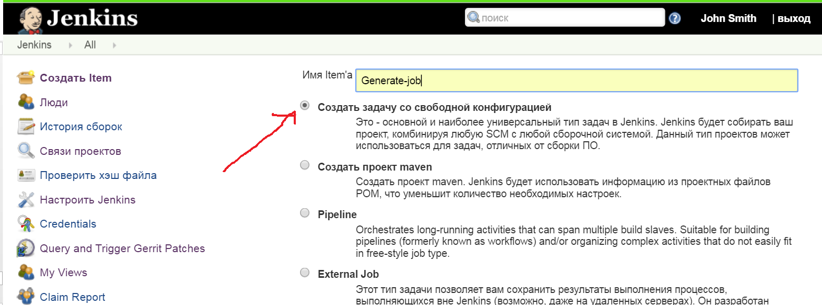
Click add Item:

Slide 26
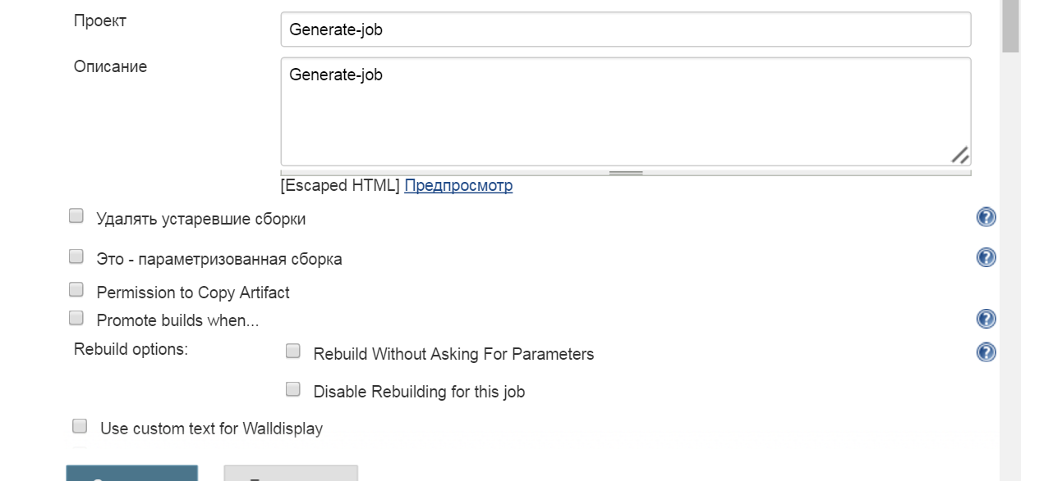
Let’s create freestyle initial job which will be generate another jobs : tomcat setup, build, deploy

Slide 27
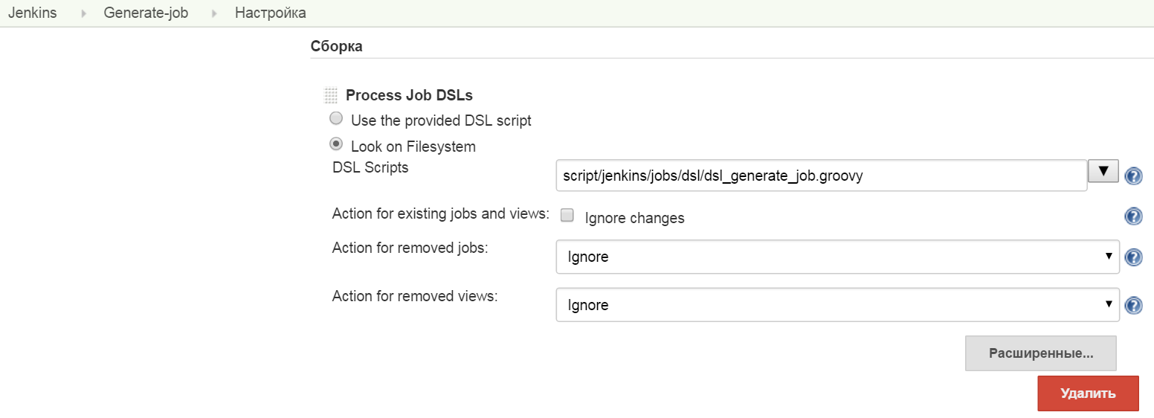
Let’s add step during build “Process Job DSLs”:

Slide 28
Let’s add step during build “Process Job DSLs”:

Slide 29
Let’s create groovy - script for job https://innersource.accenture.com/java201/java201-adop-cartidge.git
//dls_generate_jobs.groovy
def PROJECT_NAME="Master_Build" def WORKSPACE_NAME="Master_Build" // Folders def workspaceFolderName = "${WORKSPACE_NAME}" def projectFolderName = "${PROJECT_NAME}" // Variables def referenceAppGitRepo = "master" def referenceAppGitUrl = "https://github.com/adm3942soit/Master.git"

Slide 30
Let’s see dsl_generate_job.groovy
// Jobs def buildAppJob = freeStyleJob("Master_Build") buildAppJob.with { description("This job builds Master application") wrappers { preBuildCleanup() injectPasswords() maskPasswords() sshAgent("adop-jenkins-master") } scm { git { remote { url(referenceAppGitUrl) credentials("adop-jenkins-master") } branch("*/master") } } environmentVariables { env('WORKSPACE_NAME',workspaceFolderName) env('PROJECT_NAME',projectFolderName) env("ENVIRONMENT_NAME",'CI') } label("java8") triggers{ gerrit{ events{ refUpdated() } configure { gerritxml -> gerritxml / 'gerritProjects' { 'com.sonyericsson.hudson.plugins.gerrit.trigger.hudsontrigger.data.GerritProject' { compareType("PLAIN") pattern(referenceAppGitRepo) 'branches' { 'com.sonyericsson.hudson.plugins.gerrit.trigger.hudsontrigger.data.Branch' { compareType("PLAIN") pattern("master") } } } } gerritxml / serverName("ADOP Gerrit") } } } steps { maven{ goals('clean install -DskipTests') mavenInstallation("maven") } } publishers{ archiveArtifacts("**/*") } } queue("Master_Build")

Slide 31
Creating view:
// Views def pipelineView = buildPipelineView("Master_Application") pipelineView.with{ title('Master_Application Pipeline') displayedBuilds(5) selectedJob("Master_Build") showPipelineParameters() showPipelineDefinitionHeader() refreshFrequency(5) } queue("Master_Application")

Slide 32
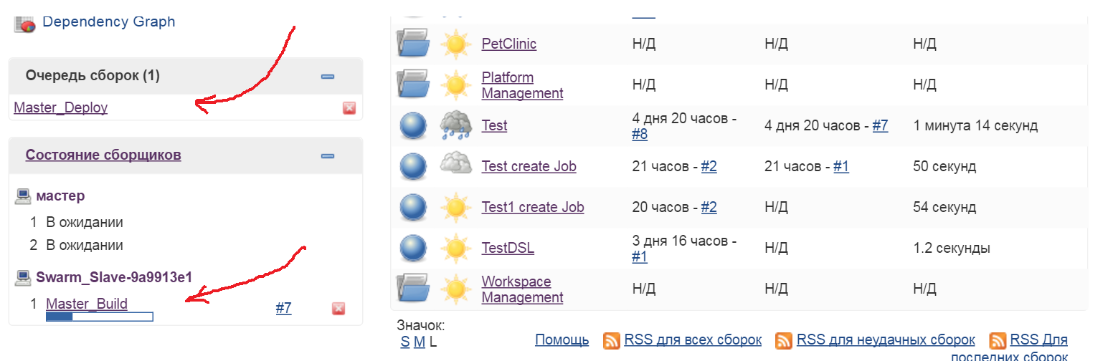
Result:

Slide 33
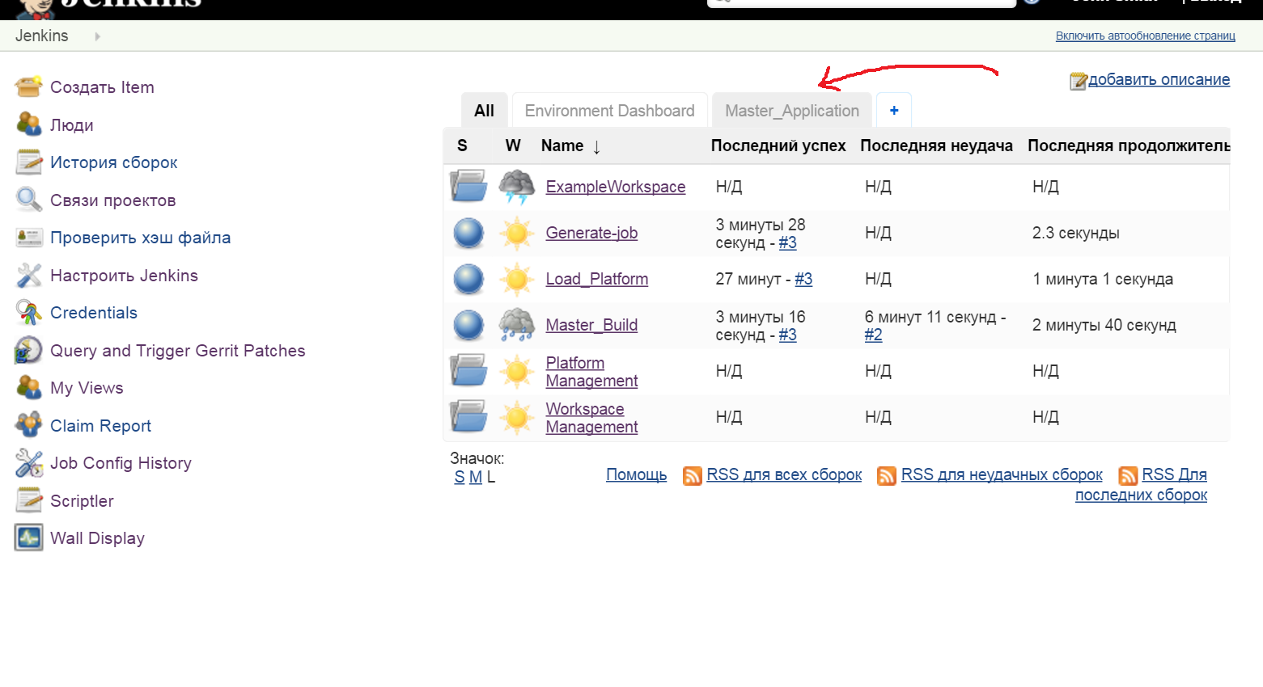
Created view “Master_Application”

Slide 34
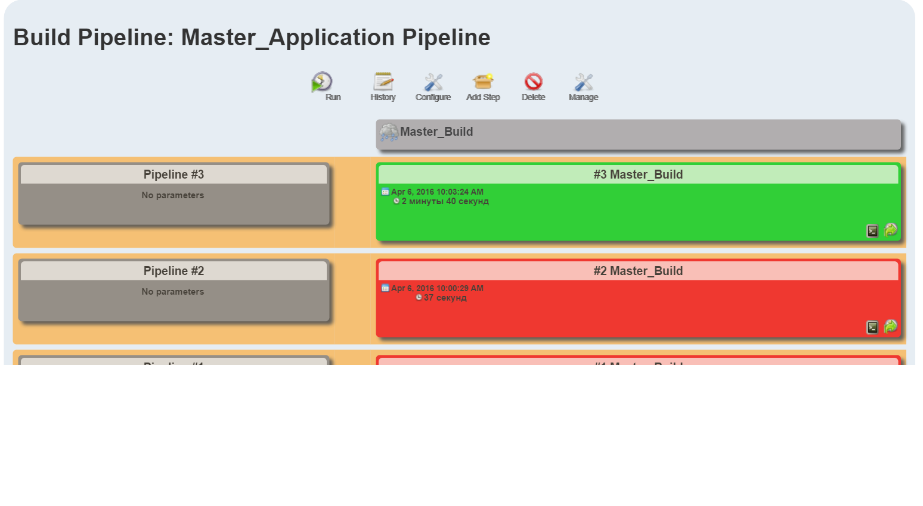
Click “Master_Application” tab:

Slide 35
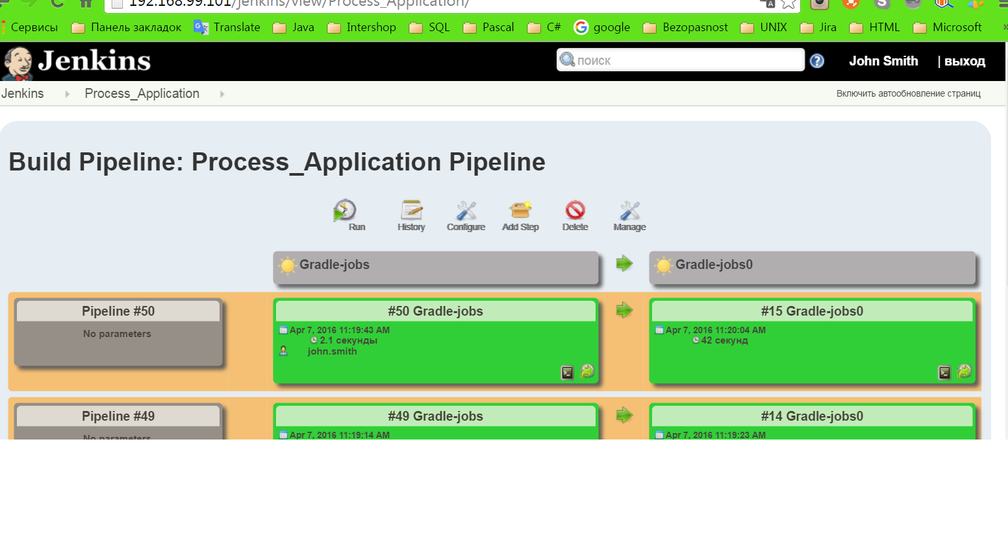
Let’s add downstream-projects to view:

Slide 36
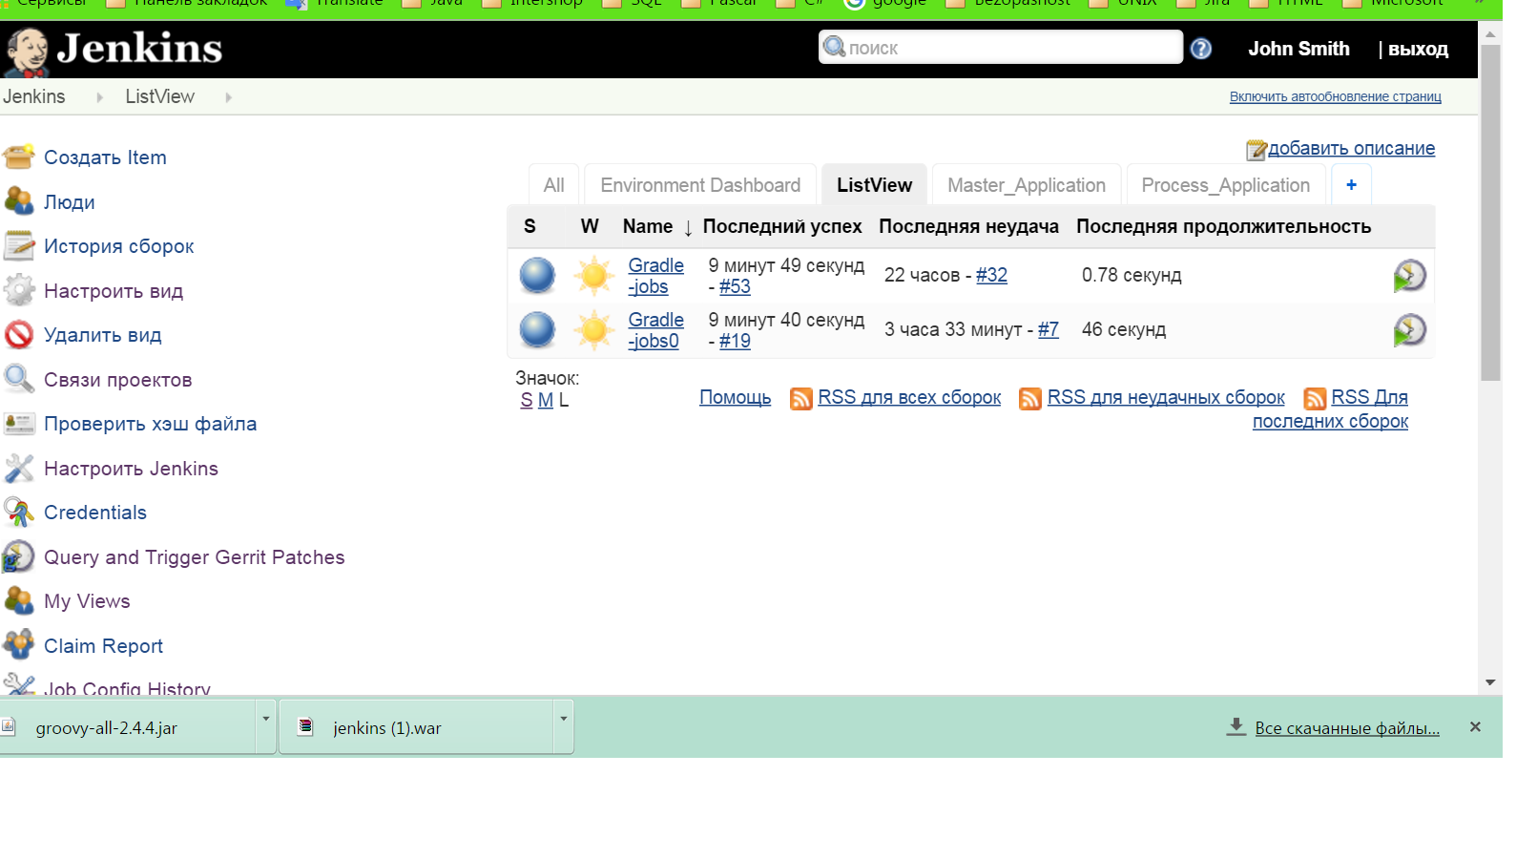
Let’s add new listview with button “Build”

Slide 37
Groovy script for this you will find in repository:
https://innersource.accenture.com/java201/java201-adop-cartidge.git

Slide 38
References
http://sheehan.github.io/job-dsl-slides/#/
http://codeventor.blogspot.com/2015/06/jenkins-dsl-scripting-part-1-basics-tldr.html
http://codeventor.blogspot.com/2015/07/jenkins-dsl-scripting-part-2-basics.html
http://codeventor.blogspot.com/2015/07/jenkins-dsl-scripting-part-3.html
http://codeventor.blogspot.com/2015/07/jenkins-dsl-scripting-part-4-adding-new-commands.html

